Slide 1


Data Structures
ETCCBD201
Ms. Jyoti Yadav
Faculty
School of Engineering & Technology
K.R. Mangalam University
Unit 2 : Linear Data Structures

Slide 2

Unit-2 Linear Data Structures
SESSION 11 Arrays – 1D & 2D
SESSION 12 Static & Dynamic Arrays
SESSION 13 Linked Lists Types
SESSION 14 Linked List Operations
SESSION 15 Stack ADT & Operations
SESSION 16 Stack Applications
SESSION 17 Queue ADT
SESSION 18 Queue Applications
SESSION 19 BFS using Queue
SESSION 20 Revision (Unit–2)
Notes:
New Courses replaced with New Programmes

Slide 3
Stack Applications
Session 16
Introduction to Stack Applications
Why Stack is Suitable for Problem Solving (LIFO)
Applications of Stack – Overview
Expression Evaluation Using Stack
Expression Conversion Using Stack
Algorithms for Expression Conversion
Evaluation of Prefix & Postfix Expressions
Reversing Data Using Stack
Function Calls & Call Stack
Backtracking – Tower of Hanoi
Delimiter / Parenthesis Checking
Worked Examples & Practice Problems
Common Errors & Edge Cases
Key Takeaways
Quick Quiz
References
Notes:
New Courses replaced with New Programmes

Slide 4
Recapitulation (Stack ADT and Operations)
A stack is a linear data structure that follows the LIFO (Last In, First Out) principle.
All insertions and deletions occur only at one end called the TOP.
Basic stack operations are: push, pop, peek/top, isEmpty, isFull.
Stack overflow occurs when pushing into a full stack.
Stack underflow occurs when popping from an empty stack.
Stack can be implemented using arrays (fixed size) or linked lists (dynamic size).
Push and pop operations take O(1) time in most cases.
Stacks are used in expression evaluation, recursion, undo/redo operations, parsing, and memory management.
Notes:
New Courses replaced with New Programmes

Slide 5
Quick Quiz
Fill in the Blanks
Stack follows the __________ principle.
The end of the stack where insertion and deletion occur is called the __________.
The operation used to insert an element into a stack is called __________.
Stack underflow occurs when we try to __________ from an empty stack.
Notes:
New Courses replaced with New Programmes

Slide 6
Quick Quiz
One-Word / Short Answer Questions
Name the operation that removes the top element of the stack.
Which data structure is used to implement a dynamic stack?
What is the time complexity of the push operation?
Which pointer/index indicates the top of the stack?
Application-Based Questions
Why is stack suitable for undo/redo operations?
Which stack principle is used in expression evaluation?
Notes:
New Courses replaced with New Programmes

Slide 7
Quick Quiz (Answers)
LIFO
TOP
Push
Pop
Pop
Linked list
O(1)
Top
Because the last action is undone first (LIFO).
LIFO
Notes:
New Courses replaced with New Programmes

Slide 8
Learning Objectives
After this lecture, students will be able to:
List major applications of stack in data structures
Explain how LIFO helps in solving computational problems
Differentiate between infix, prefix, and postfix expressions
Convert expressions between different notations using stack
Evaluate prefix and postfix expressions using stack algorithms
Apply stack to reverse data, handle function calls, and solve backtracking problems
Analyze the time and space complexity of stack-based algorithms
Notes:
New Courses replaced with New Programmes

Slide 9
Application of Stack in Data Structure are :
Evaluation of Arithmetic Expressions
Reverse a Data
Processing Function Calls
Backtracking (Tower of Hanoi Problem)
Delimiter Checking
Notes:
New Courses replaced with New Programmes

Slide 10
Expression Evaluation Using Stack
An arithmetic expression can be represented as a string consisting of:
Operands (numbers or variables)
Operators (+ , − , * , /)
Parentheses ( )
You may assume that:
All parentheses are well-matched
Only binary operators (+ , − , * , /) are used
Notes:
New Courses replaced with New Programmes

Slide 11
Expression Evaluation Using Stack
Arithmetic expressions can be written in three different notations:
Infix Notation – Operator is placed between operands
A + B
Prefix Notation (Polish Notation) – Operator is placed before operands
+ A B
Postfix Notation (Reverse Polish Notation) – Operator is placed after operands
A B +
Stacks are commonly used to convert between these notations and to evaluate prefix and postfix expressions efficiently.
Notes:
New Courses replaced with New Programmes

Slide 12
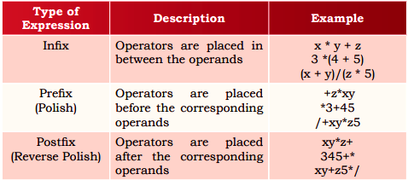
Notations for Arithmetic Expression
https://www.sarthaks.com/3456368/notations-for-arithmetic-expressions
Notes:
New Courses replaced with New Programmes

Slide 13
The standard precedence rules for arithmetic expression
Operators | Associativity | Precedence
^ exponentiation | Right to left | Highest followed by *Multiplication and /division
*Multiplication, /division | Left to right | Highest followed by + addition and - subtraction
+ addition, - subtraction | Left to right | lowest
Notes:
New Courses replaced with New Programmes

Slide 14
Check for Understanding
Which notation is easiest for a computer to evaluate?
Which data structure is used to store operators during infix to postfix conversion?
What is the time complexity of postfix evaluation using stack?
Which element is removed first during evaluation?
Notes:
New Courses replaced with New Programmes

Slide 15
Check for Understanding (Answers)
Postfix
Stack
O(n)
Top element
Notes:
New Courses replaced with New Programmes

Slide 16
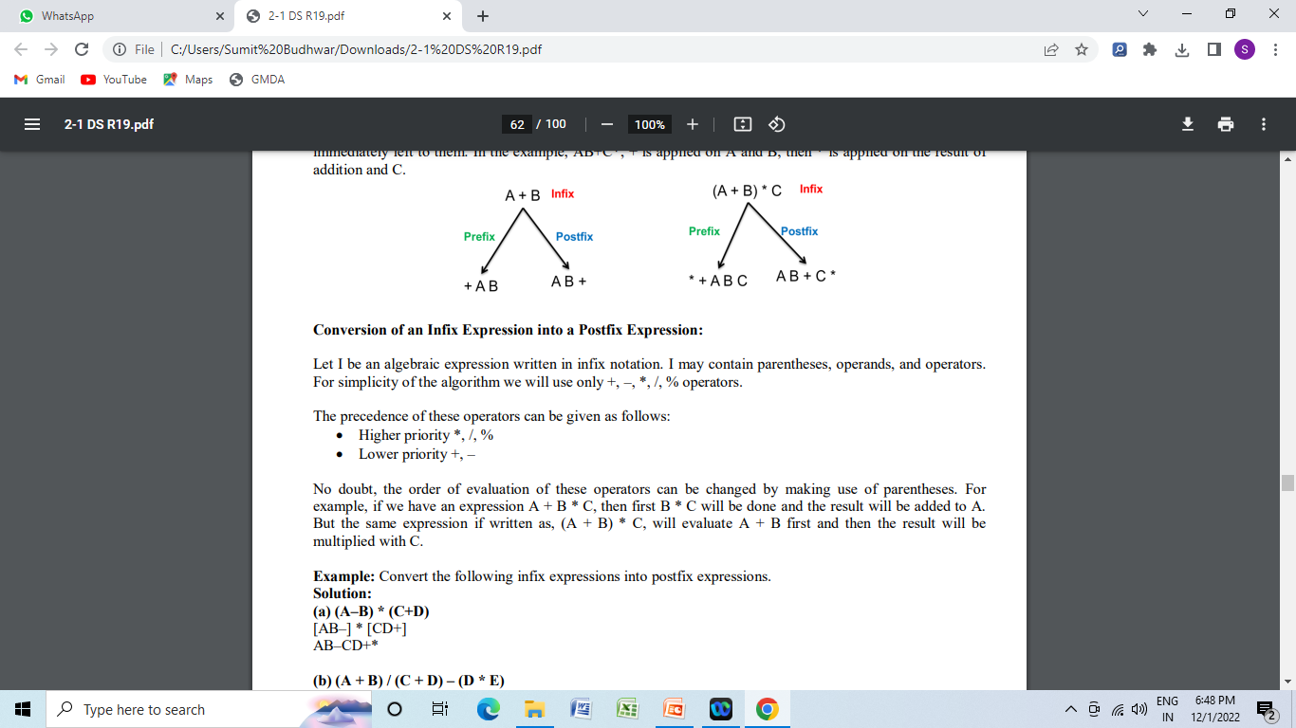
Conversion
Infix to Postfix
Infix to Prefix
Postfix to Prefix
Postfix to In fix
Pre fix to Infix
Pre fix to postfix
Notes:
New Courses replaced with New Programmes

Slide 17
Infix to Postfix
Algorithm for Conversion of Infix to Postfix :
Scan all the symbols one by one from left to right in the given Infix Expression.
If the reading symbol is an operand, then immediately append it to the Postfix Expression.
If the reading symbol is left parenthesis ‘( ‘, then Push it onto the Stack.
If the reading symbol is right parenthesis ‘)’, then Pop all the contents of the stack until the respective left parenthesis is popped and append each popped symbol to Postfix Expression.
Notes:
New Courses replaced with New Programmes

Slide 18
Infix to Postfix
Algorithm for Conversion of Infix to Postfix :
If the reading symbol is an operator (+, –, *, /), then Push it onto the Stack. However, first, pop the operators that are already on the stack that have higher or equal precedence than the current operator and append them to the postfix. If an open parenthesis is there on top of the stack, then push the operator into the stack.
If the input is over, pop all the remaining symbols from the stack and append them to the postfix.
Notes:
New Courses replaced with New Programmes

Slide 19
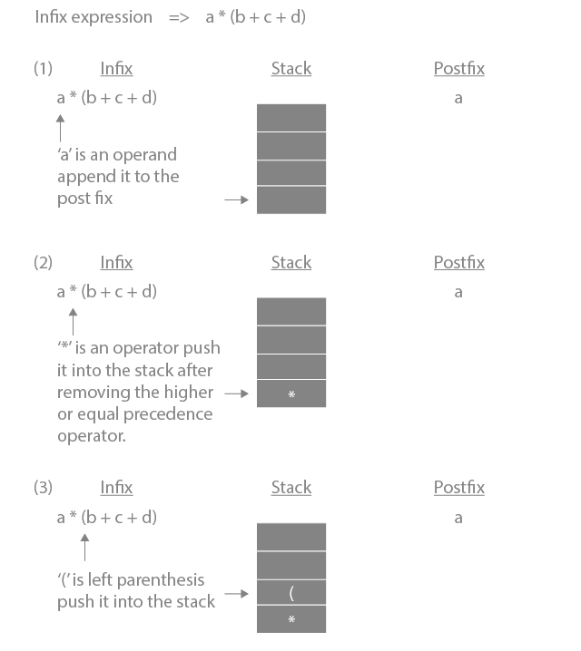
Infix to Postfix
Notes:
New Courses replaced with New Programmes

Slide 20
Infix to Postfix
Notes:
New Courses replaced with New Programmes

Slide 21
Infix to Postfix
Notes:
New Courses replaced with New Programmes

Slide 22
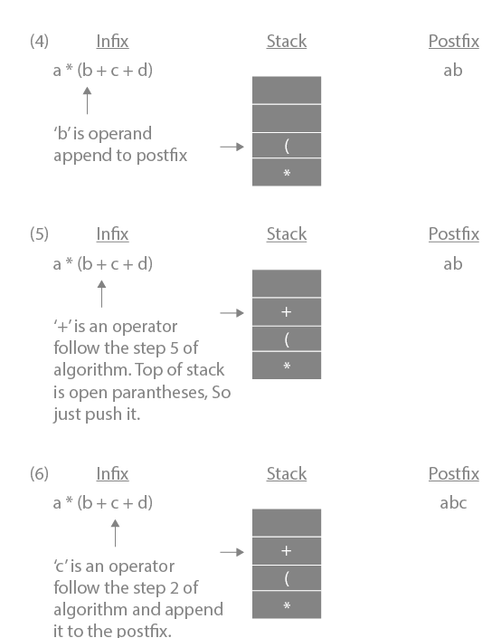
Infix to Postfix
Notes:
New Courses replaced with New Programmes

Slide 23
Infix to Postfix
Notes:
New Courses replaced with New Programmes

Slide 24
Infix to Postfix
Notes:
New Courses replaced with New Programmes

Slide 25
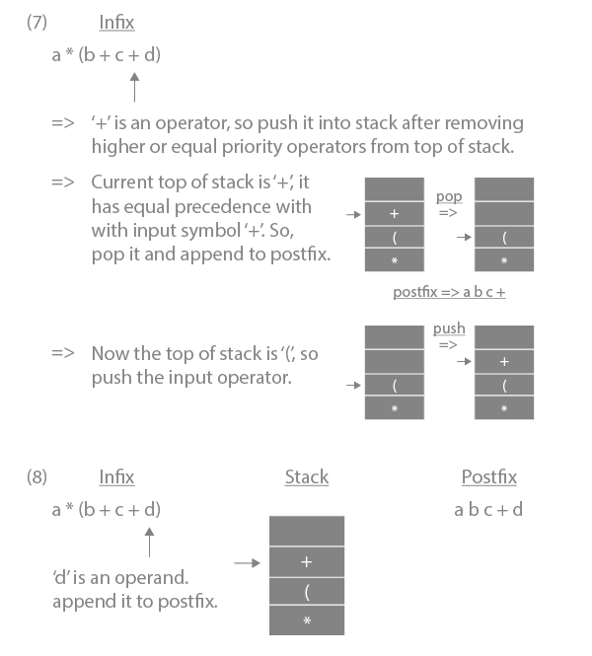
Infix to Postfix
Notes:
New Courses replaced with New Programmes

Slide 26
Infix to Postfix
Notes:
New Courses replaced with New Programmes

Slide 27
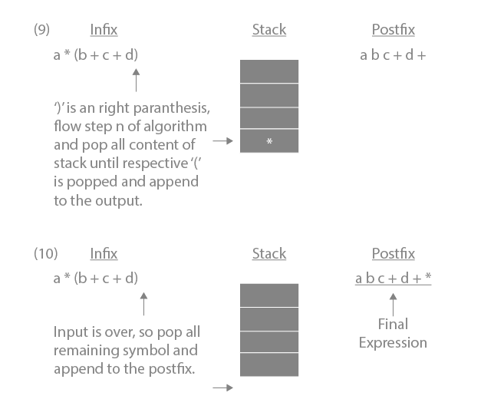
Infix to Postfix
https://www.prepbytes.com/blog/stacks/infix-to-postfix-conversion-using-stack/
Notes:
New Courses replaced with New Programmes

Slide 28
Infix to Postfix
https://www.prepbytes.com/blog/stacks/infix-to-postfix-conversion-using-stack/
Notes:
New Courses replaced with New Programmes

Slide 29
Quick Check
Here is an infix expression: 4 + 3*(6*3-12). Suppose that we are using the usual stack algorithm to convert the expression from infix to postfix notation. The maximum number of symbols that will appear on the stack AT ONE TIME during the conversion of this expression?
a) 1 b) 2 c) 3 d) 4
Notes:
New Courses replaced with New Programmes

Slide 30
Quick Check (Answer)
Here is an infix expression: 4 + 3*(6*3-12). Suppose that we are using the usual stack algorithm to convert the expression from infix to postfix notation. The maximum number of symbols that will appear on the stack AT ONE TIME during the conversion of this expression?
a) 1 b) 2 c) 3 d) 4
Notes:
New Courses replaced with New Programmes

Slide 31
Infix to Prefix
Converting Infix Expression to Prefix Expression:
First, flip the infix expression. Keep in mind that when reversed, each "(" will become a ")" and each ")" a "(".
The second step is to "nearly" postfix the reversed infix expression.
Instead of performing the pop operation to remove operators with greater than or equal precedence during the conversion to a postfix expression, we will only remove the operators from the stack that have a higher precedence in this case.
Reverse the postfix expression in step three.
Infix expressions are converted to postfix forms using the stack
Notes:
New Courses replaced with New Programmes

Slide 32
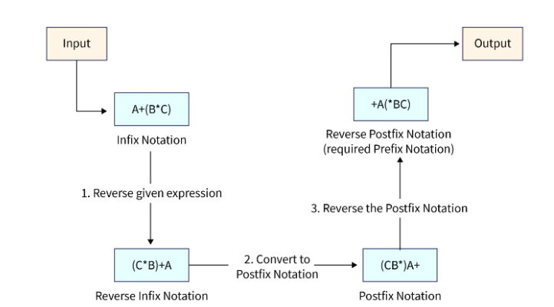
Infix to Prefix
Notes:
New Courses replaced with New Programmes

Slide 33
Quick Check
1. What would be the Prefix notation for the given equation?
A^B^C^D
^^^ABCD
^A^B^CD
ABCD^^^
AB^C^D
2. What would be the Prefix notation for the given equation?
a+b-c/d&e|f
|&-+ab/cdef
&|-+ab/cdef
|&-ab+/cdef
|&-+/abcdef
Notes:
New Courses replaced with New Programmes

Slide 34
Quick Check (Answers)
Answer: b
Explanation: Reverse the equation or scan the equation from right to left. Apply the infix-prefix algorithm. Here we have to remember that the exponentiation has order of associativity from right to left. Therefore, the final answer will be ^A^B^CD.
2. Answer: a
Explanation: Reverse the equation or scan the equation from right to left. Apply the infix-prefix algorithm. The preference order in ascending order are as follows |&+*/.
Notes:
New Courses replaced with New Programmes

Slide 35
Postfix to Prefix
Conversion of Postfix to Prefix expression :
Scan all symbols one by one from left to right in the given prefix expression .
If the reading symbol is an operand , push it into the stack .
If the reading symbol is an operator , then a. Pop two expression from the stack , operand1 and operand2 , which is operand for the current operator b. Push operator + operand2 + operand1 into the stack
If there is no symbol left then stop the process . Top of the stack will have the required infix expression .
Notes:
New Courses replaced with New Programmes

Slide 36
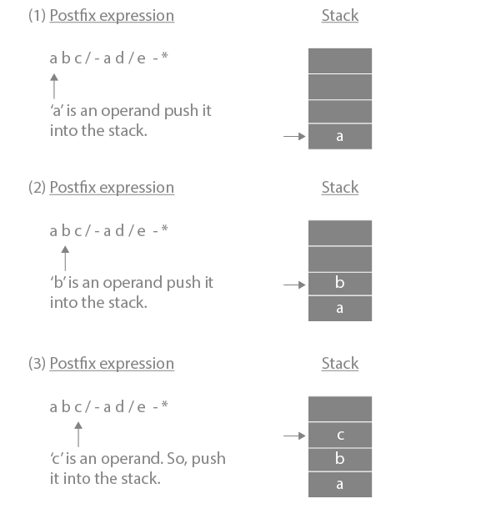
Postfix to Prefix
Notes:
New Courses replaced with New Programmes

Slide 37
Postfix to Prefix
Notes:
New Courses replaced with New Programmes

Slide 38
Postfix to Prefix
Notes:
New Courses replaced with New Programmes

Slide 39
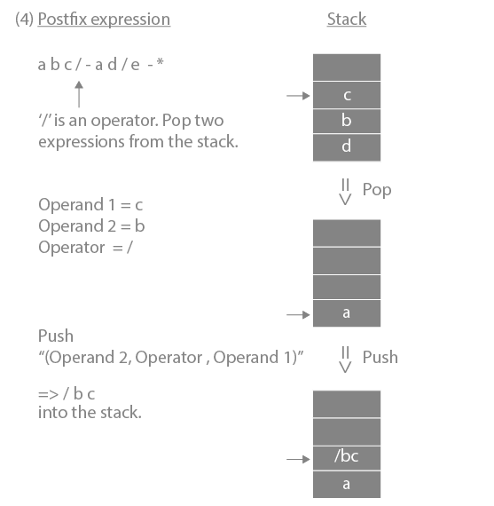
Postfix to Prefix
Notes:
New Courses replaced with New Programmes

Slide 40
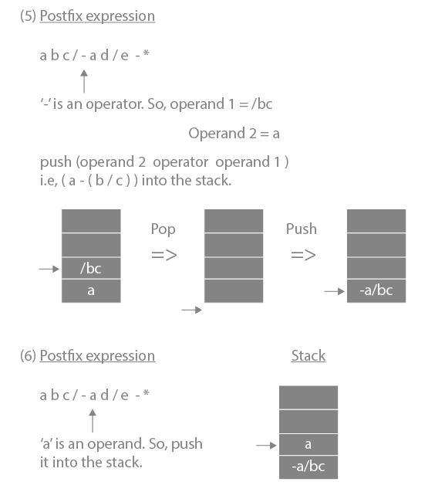
Postfix to Prefix
Notes:
New Courses replaced with New Programmes

Slide 41
Postfix to Prefix
Notes:
New Courses replaced with New Programmes

Slide 42
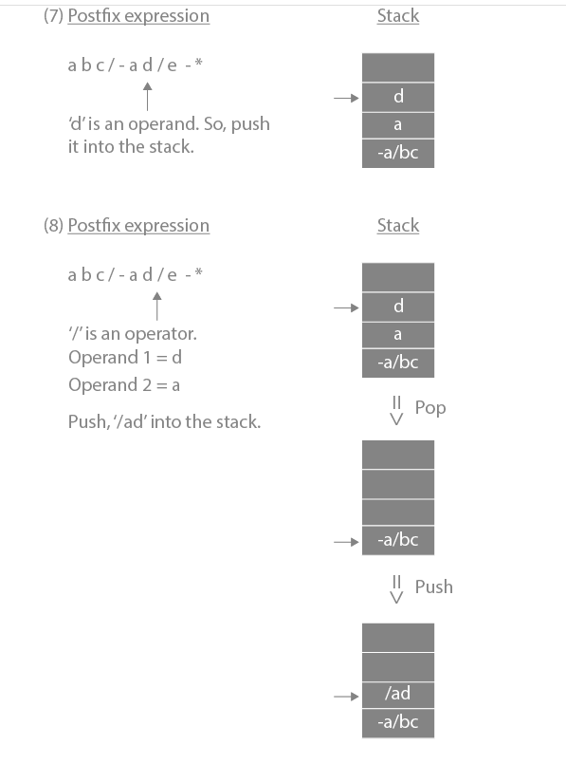
Postfix to Prefix
Notes:
New Courses replaced with New Programmes

Slide 43
Postfix to Prefix
Notes:
New Courses replaced with New Programmes

Slide 44
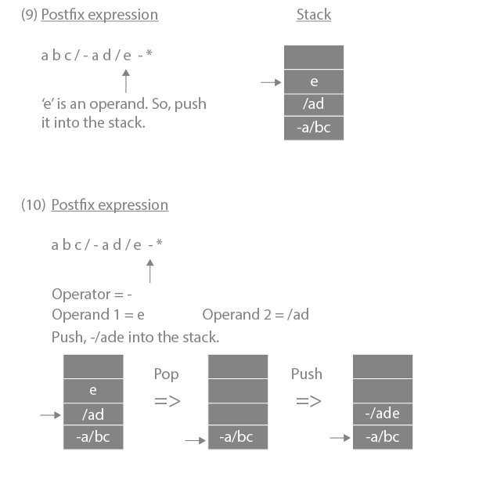
Postfix to Prefix
Notes:
New Courses replaced with New Programmes

Slide 45
Postfix to Prefix
Notes:
New Courses replaced with New Programmes

Slide 46
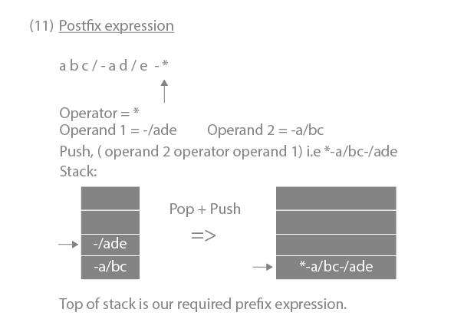
Postfix to Prefix
https://www.prepbytes.com/blog/stacks/postfix-to-prefix conversion/#:~:text=For%20converting%20Postfix%20to%20Prefix,will%20be%20our%20prefix%20expression%20.
Notes:
New Courses replaced with New Programmes

Slide 47
Postfix to Infix
Scan the given postfix expression from left to right character by character.
If the character is an operand, push it into the stack.
But if the character is an operator, pop the top two values from stack. Concatenate this operator with these two values (2nd top value+operator+1st top value) to get a new string.
Now push this resulting string back into the stack.
Repeat this process until the end of postfix expression. Now the value in the stack is the infix expression.
Notes:
New Courses replaced with New Programmes

Slide 48
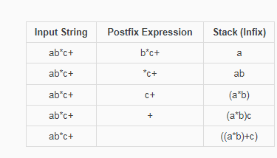
Postfix to Infix
Notes:
New Courses replaced with New Programmes

Slide 49
Prefix to Infix converter step by step
Start scanning the prefix expression from right to left.
If the current character is an operand (a number or a variable), push it onto a stack.
If the current character is an operator (+, -, *, /, ^), pop two operands from the stack and concatenates them with the operator in between to form an infix sub-expression. Then push the infix sub-expression onto the stack.
Repeat steps 2 and 3 until the entire prefix expression has been scanned.
The final infix expression will be the only item remaining on the stack.
Notes:
New Courses replaced with New Programmes

Slide 50
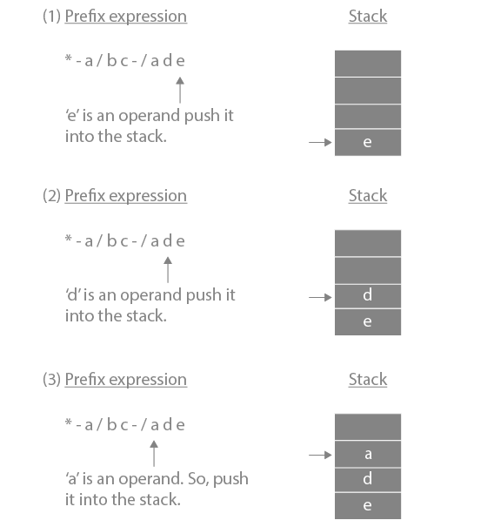
Prefix to Infix converter step by step
Notes:
New Courses replaced with New Programmes

Slide 51
Prefix to Infix converter step by step
Notes:
New Courses replaced with New Programmes

Slide 52
Prefix to Infix converter step by step
Notes:
New Courses replaced with New Programmes

Slide 53
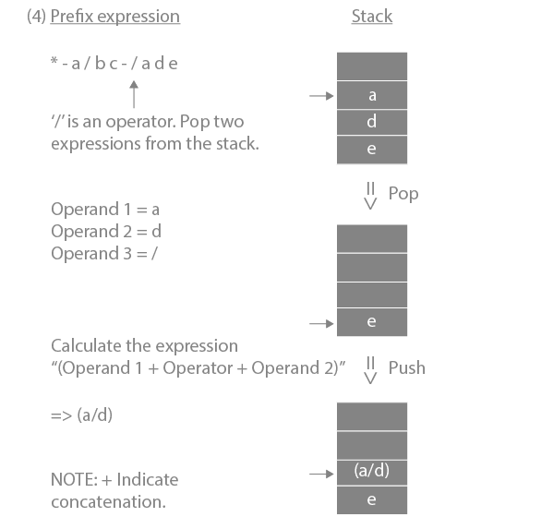
Prefix to Infix converter step by step
Notes:
New Courses replaced with New Programmes

Slide 54
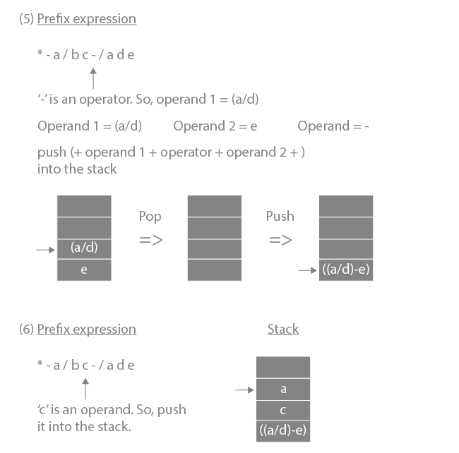
Prefix to Infix converter step by step
Notes:
New Courses replaced with New Programmes

Slide 55
Prefix to Infix converter step by step
Notes:
New Courses replaced with New Programmes

Slide 56
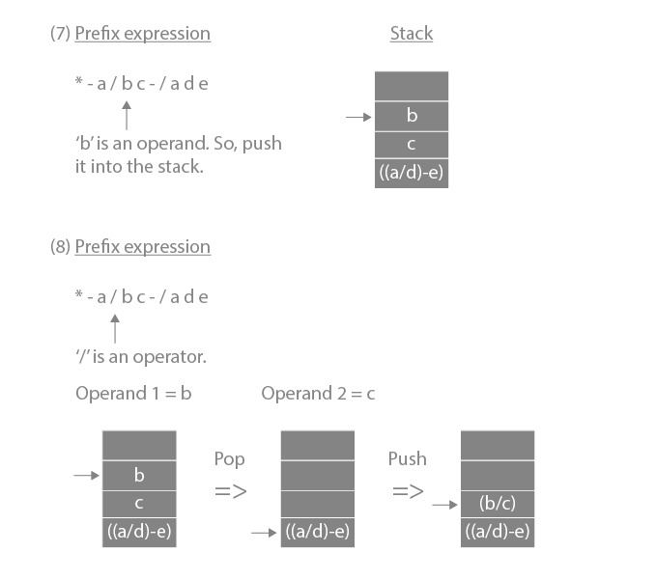
Prefix to Infix converter step by step
Notes:
New Courses replaced with New Programmes

Slide 57
Prefix to Infix converter step by step
Notes:
New Courses replaced with New Programmes

Slide 58
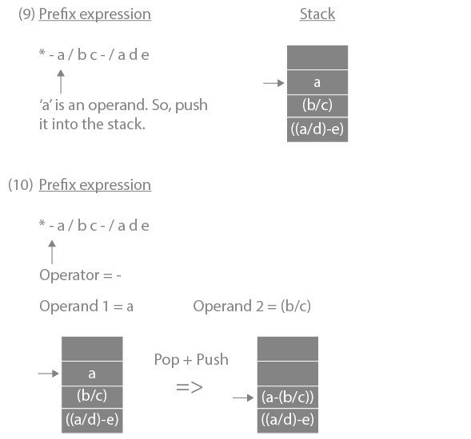
Prefix to Infix converter step by step
Notes:
New Courses replaced with New Programmes

Slide 59
Prefix to Infix converter step by step
Notes:
New Courses replaced with New Programmes

Slide 60
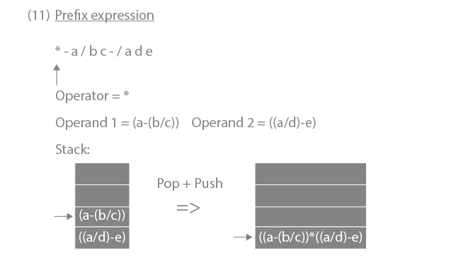
Prefix to Infix converter step by step
https://www.prepbytes.com/blog/stacks/conversion-of-prefix-expression-to-infix-expression/
Notes:
New Courses replaced with New Programmes

Slide 61
Prefix to Postfix converter step by step
Step 1: Scan all symbols one by one from right to left in the given prefix expression.
Step 2: If the reading symbol is an operand, push it into the stack.
Step 3: If the reading symbol is an operator, then
a. Pop two expressions from the stack, operand1, and operand2, which is the operand for the current operator
b. Push operand1 + operand2 + operator into the stack
Step 4: If there is no symbol left then stop the process. The top of the stack will have the required postfix expression.
Notes:
New Courses replaced with New Programmes

Slide 62
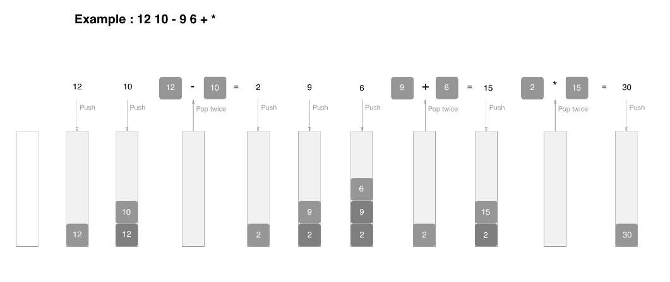
Postfix Evaluation Example
Notes:
New Courses replaced with New Programmes

Slide 63
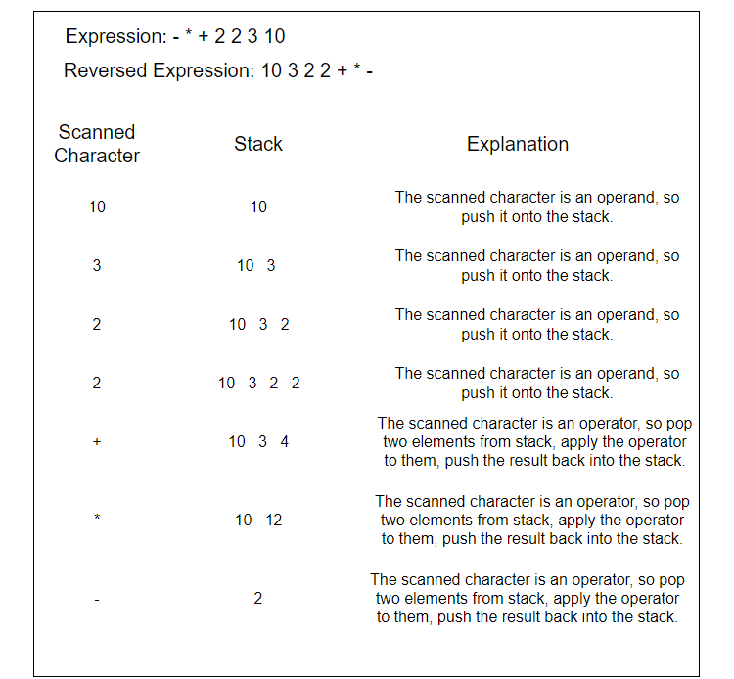
Prefix Evaluation Example
Notes:
New Courses replaced with New Programmes

Slide 64
Infix Expression to Postfix Expression
Question: Validate the given expression: 69 ^ 87 - 67 / 29 + 77 * 44
Step 1: ( 69 ^ 87 ) - 67 / 29 + 77 * 44 Note: Since ^ has highest priority it is parenthesized first.
Step 2: ( 69 ^ 87 ) - ( 67 / 29 ) + 77 * 44 / and * have the next priority but / is parenthesized first because they follow left associativity.
Step 3: ( 69 ^ 87 ) - ( 67 / 29 ) + ( 77 * 44 ) / and * have the next priority but * is parenthesized second because they follow left associativity.
Step 4: ( ( 69 ^ 87 ) - ( 67 / 29 ) ) + ( 77 * 44 )
Step 5: ( ( ( 69 ^ 87 ) - ( 67 / 29 ) ) + ( 77 * 44 ) )
Notes:
New Courses replaced with New Programmes

Slide 65
Infix Expressions into Postfix Expressions
Solution:
(a) (A–B) * (C+D)
[AB–] * [CD+]
AB–CD+*
(b) (A + B) / (C + D) – (D * E)
[AB+] / [CD+] – [DE*]
[AB+CD+/] – [DE*]
AB+CD+/DE*–
Notes:
New Courses replaced with New Programmes

Slide 66
Postfix Expressions into Infix Expressions
Solution:
Postfix: (ABC/-AK/L-*
Infix expression: ((A-(B/C))*((A/K)-L))
Notes:
New Courses replaced with New Programmes

Slide 67
Test Yourself
1. Why is there a need to convert from infix to postfix and then evaluate, instead of directly evaluating the infix?
a: It is easier to read for humans
b: It is easier to parse (be read by a computer).
c: Both a and b
d: None of these.
2. Postfix evaluation of 1 2 + 3 9 - + 4 + is _______.
a: 3
b: 2
c: 1
d: 4
Notes:
New Courses replaced with New Programmes

Slide 68
Test Yourself
3. Convert the expression from infix to postfix 1 + 1 - 3 * 4 / 2 + 3 - 8?
a: 1 1 + 3 - 4 * 2 / + 3 8 -
b: 1 1 + 3 - 4 / 2 * 3 + 8 -
c: 1 1 + 3 4 * 2 / - 3 + 8 -
d: 1 1 * 3 + 4 - 2 + 3 / 8 –
4. Convert the expression from Infix to Postfix a + b * (c ^ d - e) ^ (f + g * h) - i?
a: ab^cd-ef+d*h^*-i+
b: ab^cd-ef+d*h*^-i+
c: abcd^e-fgh*+^*+i-
d: abcd^e-fgh*+*^+i-
Notes:
New Courses replaced with New Programmes

Slide 69
Test Yourself
5. Convert the expression from Infix to Postfix a + b * c - d ^ e ^ f?
a: abc * + def ^^-
b: abc * + de ^ f ^-\
c: ab + c *d - e ^ f ^
d: -+ a * bc ^^ de
Notes:
New Courses replaced with New Programmes

Slide 70
Correct Answers
1.b
2.c
3.c
4.c
5.a
Notes:
New Courses replaced with New Programmes

Slide 71
Practice Questions
Translate the following infix expression to its postfix equivalent expression: A + B * (C + D) / F + D * E Also write the algorithm that you used for this conversion and evaluate the postfix expression’s value for A=10, B=27, C=3 D=5 F=4 and E= 2
How can you use stack to convert an infix expression to postfix? Convert infix expression (A + B)*(C - D) to postfix using stack.
Infix Expression: ( AX + ( B * C ) )
Postfix Expression
Prefix Expression
Notes:
New Courses replaced with New Programmes

Slide 72
Practice Questions
Infix Expression: ( AX * ( BX * ( ( ( CY + AY ) + BY ) * CX ) ) ) ;
Postfix Expression
Prefix Expression
Infix Expression: ( ( H * ( ( ( ( A + ( ( B + C ) * D ) ) * F ) * G ) * E ) ) + J ) ;
Postfix Expression
Prefix Expression
Postfix: abc*d/+ed*-
Infix Expression
Prefix Expression
Notes:
New Courses replaced with New Programmes

Slide 73
Reverse a Data
Approach to reverse a string using a stack
Push the elements/characters of the string individually into the stack of data type characters.
Pop the elements/characters individually from the Stack until the stack becomes vacant.
Add a popped component to the character array.
Convert character array to string.
Return turned around the string.
Notes:
New Courses replaced with New Programmes

Slide 74
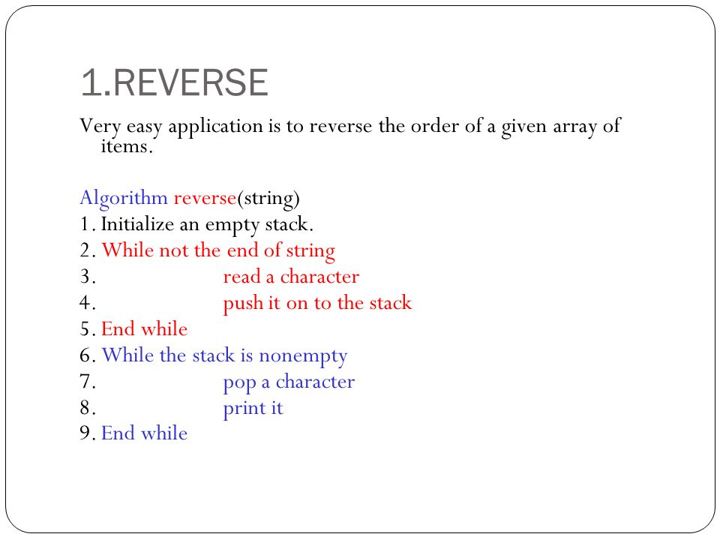
Reverse a Data
Notes:
New Courses replaced with New Programmes

Slide 75
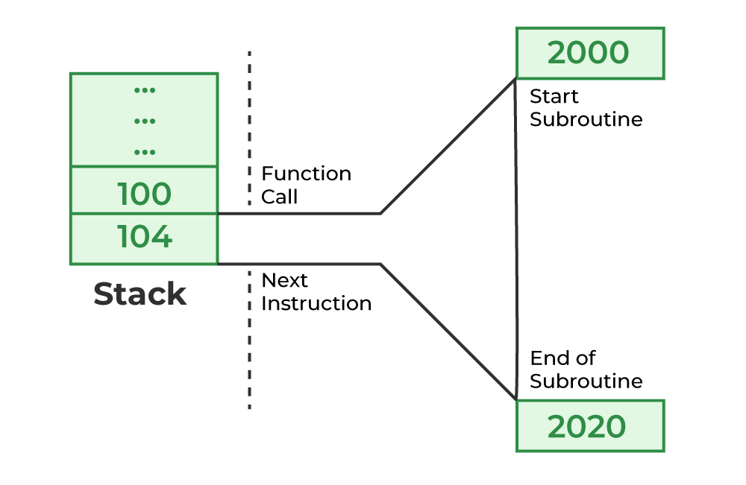
Function Calls
https://www.geeksforgeeks.org/function-call-stack-in-c/
Notes:
New Courses replaced with New Programmes

Slide 76
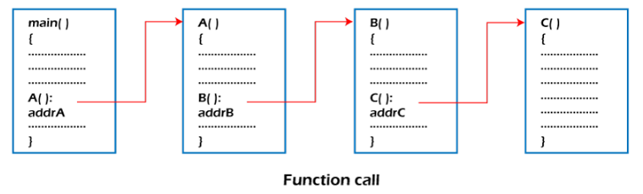
Function Calls
Stack plays an important role in programs that call several functions in succession. Suppose we have a program containing three functions: A, B, and C. function A invokes function B, which invokes the function C.
Notes:
New Courses replaced with New Programmes

Slide 77
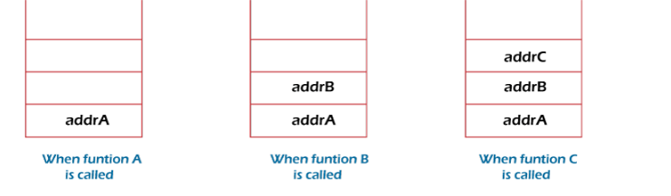
Function Calls
Consider addrA, addrB, addrC be the addresses of the statements to which control is returned after completing the function A, B, and C, respectively.
Notes:
New Courses replaced with New Programmes

Slide 78
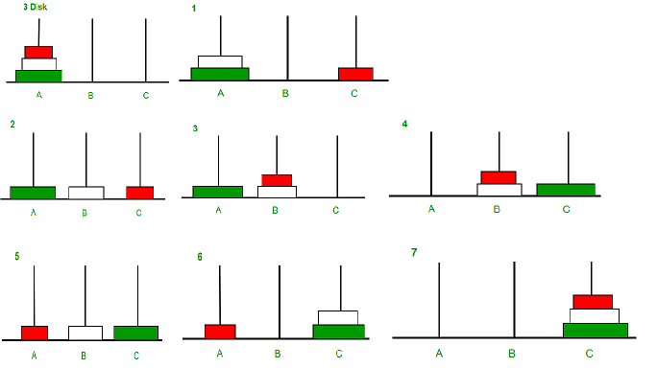
Tower of Hanoi Problem
https://www.geeksforgeeks.org/c-program-for-tower-of-hanoi//
Notes:
New Courses replaced with New Programmes

Slide 79
Tower of Hanoi Problem
Calculate the total number of moves required i.e. "pow(2, n) - 1" here n is number of disks.
If number of disks (i.e. n) is even then interchange destination pole and auxiliary pole.
for i = 1 to total number of moves:
if i%3 == 1: legal movement of top disk between source pole and destination pole if i%3 == 2: legal movement top disk between source pole and auxiliary pole if i%3 == 0: legal movement top disk between auxiliary pole and destination pole
Notes:
New Courses replaced with New Programmes

Slide 80
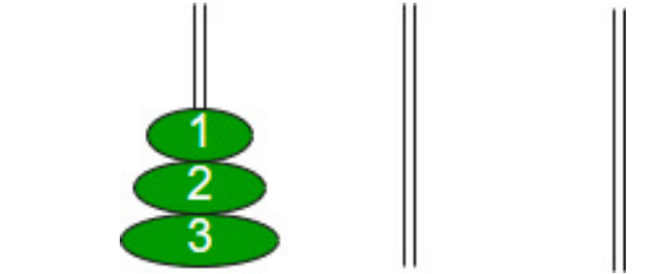
Example:
Let us understand with a simple example with 3 disks:
So, total number of moves required = 7
Notes:
New Courses replaced with New Programmes

Slide 81
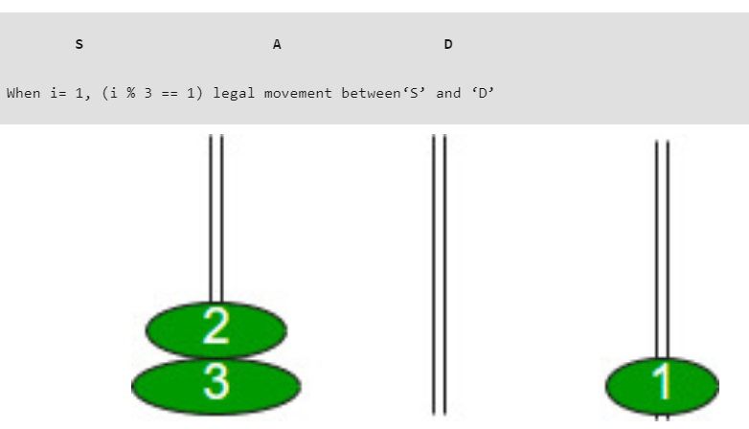
Example:
Let us understand with a simple example with 3 disks:
So, total number of moves required = 7
Notes:
New Courses replaced with New Programmes

Slide 82
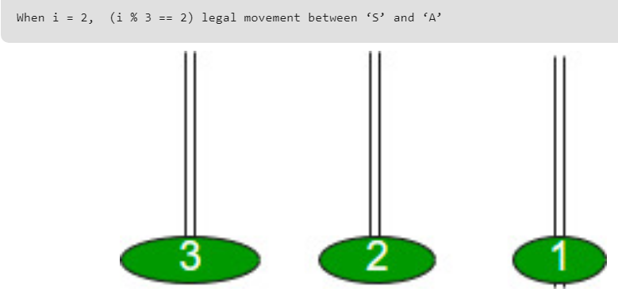
Example:
Let us understand with a simple example with 3 disks:
So, total number of moves required = 7
Notes:
New Courses replaced with New Programmes

Slide 83
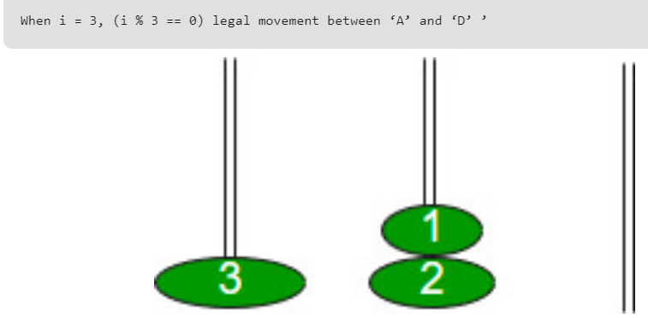
Example:
Let us understand with a simple example with 3 disks:
So, total number of moves required = 7
Notes:
New Courses replaced with New Programmes

Slide 84
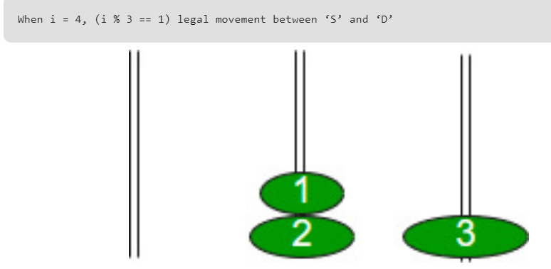
Example:
Let us understand with a simple example with 3 disks:
So, total number of moves required = 7
Notes:
New Courses replaced with New Programmes

Slide 85
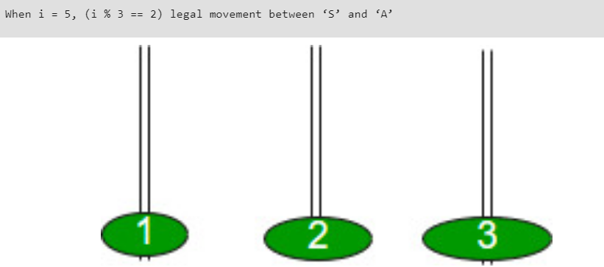
Example:
Let us understand with a simple example with 3 disks:
So, total number of moves required = 7
Notes:
New Courses replaced with New Programmes

Slide 86
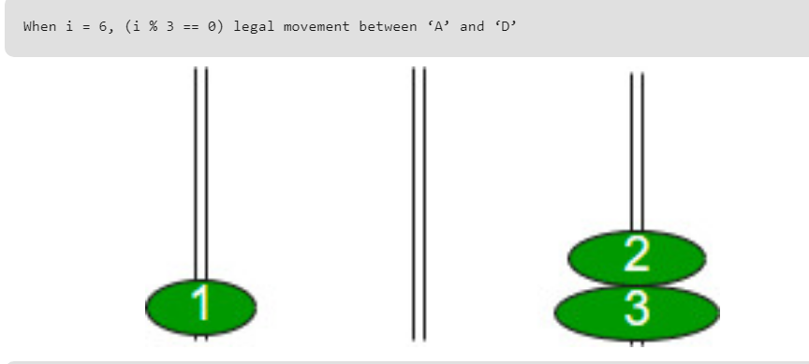
Example:
Let us understand with a simple example with 3 disks:
So, total number of moves required = 7
Notes:
New Courses replaced with New Programmes

Slide 87
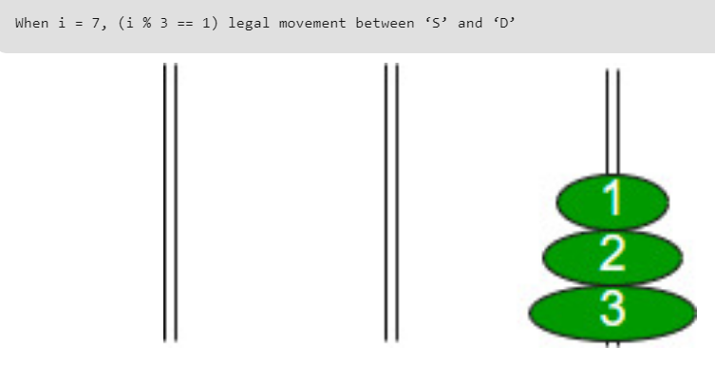
Example:
Let us understand with a simple example with 3 disks:
So, total number of moves required = 7
Notes:
New Courses replaced with New Programmes

Slide 88
Code for Tower of Hanoi (C++)
void towerOfHanoi(int n, char from_rod, char to_rod,
char aux_rod)
{
if (n == 0) {
return;
}
towerOfHanoi(n - 1, from_rod, aux_rod, to_rod);
cout << "Move disk " << n << " from rod " << from_rod
<< " to rod " << to_rod << endl;
towerOfHanoi(n - 1, aux_rod, to_rod, from_rod);
}
Complete code here
Notes:
New Courses replaced with New Programmes

Slide 89
Conceptualize
What does LIFO stand for in the context of stack data structure?
Last In, First Out
Last In, Last Out
First In, First Out
First In, Last Out
In an array-based implementation of a stack, which end is used for push and pop operations?
Front
Middle
Top
Bottom
Notes:
New Courses replaced with New Programmes

Slide 90
Conceptualize
3. What is the significance of infix, postfix, and prefix notations in stack-based evaluations?
They represent different types of data structures.
They are used to convert expressions to binary trees.
They determine the order of operations in arithmetic expressions.
They are used for heap data structure operations.
Notes:
New Courses replaced with New Programmes

Slide 91
Conceptualize
4. Which of the following is an example of a postfix expression?
A + B * C
(A + B) * C
A * B + C
A + B + C
5. Which problem is often solved using the Tower of Hanoi problem?
Sorting
Searching
Recursion
Graph Traversal
Notes:
New Courses replaced with New Programmes

Slide 92
Conceptualize
Answers:
1.a) Last In, First Out
2.c) Top
3.c) They determine the order of operations in arithmetic expressions.
4.c) A * B + C
5.c) Recursion
Notes:
New Courses replaced with New Programmes

Slide 93
Test Yourself
What is the equivalent infix expression of the following postfix expression?
M, N, O, +, *, P, /, Q, R, S, T, /, +, *, –
N*(M+Q)/Q-P*(S+R/T)
(((M*(N+O))/P)-(Q*(R+(S/T))))
O * (M + N)/P – Q * (R + S/T)
M * (N + O)/Q – P * (R/S + T)
Notes:
New Courses replaced with New Programmes

Slide 94
Test Yourself
2. What is the postfix representation of the following infix expression?
(A + B) * C – D * E / F
A B + C * D E * F – /
A B * C + D E * F / –
A B + C – D E * F / *
A B + C * D E * F / –
3. The result evaluating the postfix expression 10 5 + 60 6 / * 8 − is
284
213
142
71
Notes:
New Courses replaced with New Programmes

Slide 95
Test Yourself
4. The five items P,Q,R,S and T are pushed in a stack, one after the other starting from P. The stack is popped four times and each element is inserted in a queue. Then two elements are deleted from the queue and pushed back on the stack. now one item is popped from the stack. The popped item is:
P
R
Q
S
Notes:
New Courses replaced with New Programmes

Slide 96

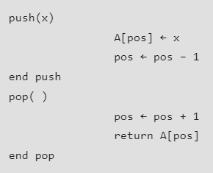
Test Yourself
5. A stack is implemented with an array of ‘A [0..N – 1]’ and a variable ‘pos’. The push and pop operations are defined by the following code.
Which of the following will initialize an empty stack with capacity N for the above implementation?
pos ← -1
pos ← 0
pos ← 1
pos ← N – 1
Notes:
New Courses replaced with New Programmes

Slide 97
Test Yourself
6. Consider the following postfix expression with single-digit operands:
6 2 3 * / 4 2 * + 6 8 * –
The top two elements of the stack after the second * is evaluated are:
6, 3
8, 1
8, 2
6, 2
7. What is the outcome of the prefix expression +, -, *, 3, 2, /, 8, 4, 1?
12
5
11
4
Notes:
New Courses replaced with New Programmes

Slide 98
Test Yourself
8. Which of the following applications may use a stack?
(a) Parenthesis balancing program
(b) Process scheduling operating system
(c) Conversion of infix arithmetic expression to postfix form
(a) and (b)
(b) and (c)
(a) and (c)
(a), (b) and (c)
Notes:
New Courses replaced with New Programmes

Slide 99
Test Yourself
9. A stack can be implemented using queue, but then we need to use at least:
3 queues
2 queues
only one queue is sufficient
none of the options
Notes:
New Courses replaced with New Programmes

Slide 100
Answers
Option 2 : (((M * (N + O)) / P) – (Q * (R + (S / T))))
Option 4 : A B + C * D E * F / –
Option 3 : 142
Option 4 : S
Option 4 : pos ← N – 1
Option 2 : 8, 1
Option 2 : 5
Option 3 : (a) and (c)
Option 2 : 2 queues
Notes:
New Courses replaced with New Programmes

Slide 101
Assignment
Let S be a stack size of 4>=1, and it is initially empty. Suppose we push the numbers 1, 2, 3, and 4, and then perform 4 pop operations. Let one push operation takes 5 ns; one pop operation takes 5 ns; the time between the end of one such stack operation and the start of the next operation is 2 ns.
The stack life of a particular element p>=1 is defined as the time elapsed from the end of push (P) to the start of the operation that removes (P) from the stack. The average stack life of an element of this stack is........................(in ns).
Notes:
New Courses replaced with New Programmes

Slide 102

Assignment
Assume stack A has the entries p, q and r (with p on top and r on bottom). Initially stack B is empty. An entry popped out of stack A can be printed immediately or pushed to stack B. A entry popped out of stack B can only be printed. The least number of stack permutations of input sequence that start with a particular letter
Consider the following infix expression which is to be converted to postfix expression using stack.
What is the size of the stack?
Notes:
New Courses replaced with New Programmes

Slide 103
Assignment
Choose the equivalent prefix form of the following expression
(a+(b-c))*((d-e)/(f+g-h))
A stack of size (1 to N) and the initial position of top pointer is 0.
Get (i, S) is a routine to get i^{th} element from stack ‘S’ with respect to top. Then, what is the underflow condition on stack to perform get() operation.
https://gateoverflow.in/115691/stack-underflow
Notes:
New Courses replaced with New Programmes

Slide 104
Questions And Answers (Stack)
What is the time efficiency of the push() and pop() operations of stacks?
The push() and pop() methods implemented in stacks take constant time to execute. i.e. the time to execute is very quick and is not dependent on the number of items on the stack. In Big O notation this is represented as O(1).
Notes:
New Courses replaced with New Programmes

Slide 105
Questions And Answers (Stack)
What is a stack and how does it work?
Answer: A stack is a linear data structure that follows the Last In, First Out (LIFO) principle. It means the last element added to the stack is the first one to be removed. Operations on a stack are performed at one end, typically called the top. Common operations include push (to add an element), pop (to remove the top element), and peek (to view the top element without removing it).
How do you implement a stack using an array?
Answer: To implement a stack using an array, we typically use an array with a fixed size and a variable to keep track of the top element's index. When pushing an element, we increment the top index and insert the element at that position. When popping an element, we retrieve the element at the top index and decrement the top index.
Notes:
New Courses replaced with New Programmes

Slide 106
Questions And Answers (Stack)
What are infix, postfix, and prefix notations? Can you provide examples of each?
Answer:
Infix notation: It is the standard way of writing arithmetic expressions, where operators are placed between operands. Example: (2 + 3) * 4
Postfix notation: Also known as Reverse Polish Notation (RPN), operators are placed after their operands. Example: 2 3 + 4 *
Prefix notation: Also known as Polish Notation, operators are placed before their operands. Example: * + 2 3 4
Notes:
New Courses replaced with New Programmes

Slide 107
Questions And Answers (Stack)
What factors determine the time complexity of an algorithm?
Answer: Time complexity depends on the number of basic operations performed by the algorithm as the size of the input increases. Common factors influencing time complexity include loop iterations, recursion depth, and the number of comparisons or assignments.
How can stacks be used to implement function calls in programming languages?
Answer: Stacks are used to manage function calls and their local variables in programming languages. When a function is called, its parameters and return address are pushed onto the stack. Local variables are allocated space on the stack, and when the function completes execution, its frame is popped off the stack.
Notes:
New Courses replaced with New Programmes

Slide 108
Questions And Answers (Stack)
How are recursion and stacks related?
Answer: Recursion involves a function calling itself, which leads to a chain of function calls. Each function call creates a new activation record (or stack frame), which is stored on the call stack. As recursion progresses, the stack grows with each function call and shrinks as functions return.
What factors influence the space complexity of a stack-based algorithm?
Answer: Space complexity depends on the amount of memory required by the algorithm, including variables, data structures, and recursion depth. For stack-based algorithms, space complexity is often influenced by the size of the call stack, especially in recursive algorithms.
Notes:
New Courses replaced with New Programmes

Slide 109
Questions And Answers (Stack)
How would you analyze the space complexity of an algorithm for converting infix to postfix expressions?
Answer: The space complexity of such an algorithm depends on the usage of additional data structures, such as stacks, to store operands, operators, and intermediate results. If the algorithm uses only a stack to convert the expression, the space complexity would be O(n), where n is the length of the input expression. However, if additional data structures are used, such as arrays or linked lists, the space complexity may vary accordingly
Notes:
New Courses replaced with New Programmes

Slide 110
Questions And Answers (Stack)
How do you handle stack underflow in an array-based implementation?
Answer: Stack underflow occurs when popping from an empty stack. To handle this, we can check if the stack is empty before performing a pop operation. If the stack is empty and a pop operation is attempted, it should raise an error or return a special value indicating underflow.
Notes:
New Courses replaced with New Programmes

Slide 111
Key Takeaways
Stack is widely used because of its LIFO behavior.
Expression conversion and evaluation become simple using stack.
Stack helps manage function calls and recursion via the call stack.
Backtracking problems like Tower of Hanoi rely on stack/recursion.
Stack is useful in reversing data, checking balanced parentheses, and parsing expressions.
Most stack-based algorithms work in linear time O(n).
Stack plays a crucial role in compilers, operating systems, and interpreters.
Notes:
New Courses replaced with New Programmes

Slide 112
References
Textbooks
Cormen, T. H., Leiserson, C. E., Rivest, R. L., & Stein, C., Introduction to Algorithms, MIT Press.
Lipschutz, S., Schaum’s Outline of Data Structures with C++, McGraw-Hill Education.
Reference Books
Weiss, M. A., Data Structures and Algorithm Analysis in C++, 5th Edition, Pearson Education.
Skiena, S. S., The Algorithm Design Manual, 3rd Edition, Springer.
Online Resources
https://practicepaper.in/gate-cse/stack
https://www.geeksforgeeks.org/introduction-to-stack-data-structure-and-algorithm-tutorials/?ref=lbp
https://www.javatpoint.com/data-structure-stack
https://www.fullstack.cafe/interview-questions/stacks
https://www.interviewkickstart.com/learn/stack-data-structure
https://www.youtube.com/watch?v=HRDHgKrYHgU
https://www.youtube.com/watch?v=Ci9jZSRn3os
https://www.udemy.com/topic/data-structures/
Notes:
New Courses replaced with New Programmes

Slide 113
THANK YOU

